Slide 1
Predicting Lyme disease in the coming decade
Avani Gowardhan
Insight DS Fellow
1st week Demo

Slide 2

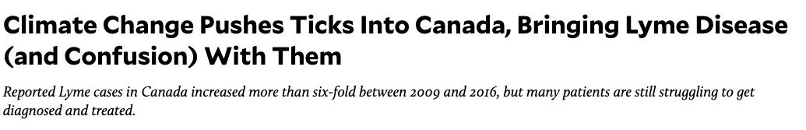
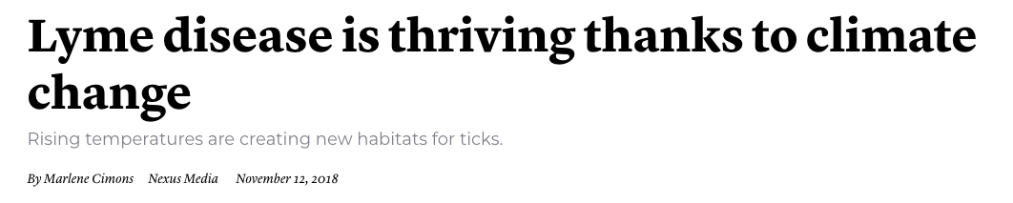
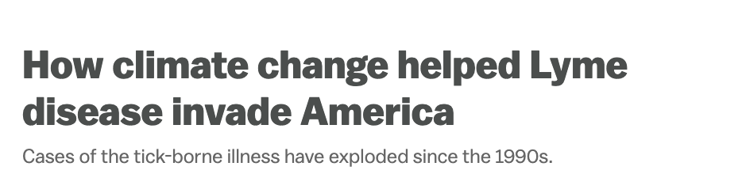
An uptick in Lyme disease in the last 20 yrs
State health departments need ~county-level disease predictions to allocate resources

Slide 3
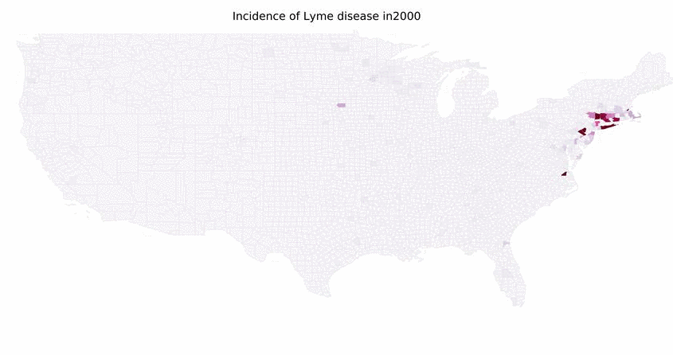
An uptick in Lyme disease in the last 20 yrs
State health departments need ~county-level disease predictions to allocate resources

Slide 4


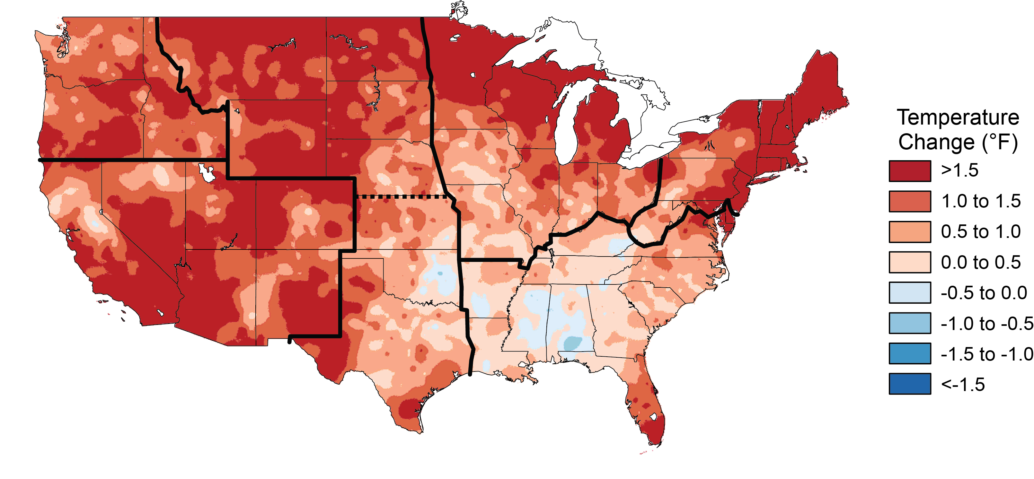
Solution
+
+
Lyme disease/county, 2000~2017
Temperature, precipitation, forest cover, deer population datasets
Projected temp, precipitation changes
Use machine learning (regression, RF, GBT) to predict incidence rates of Lyme disease over the next 2-5-10 years in each county

Slide 5
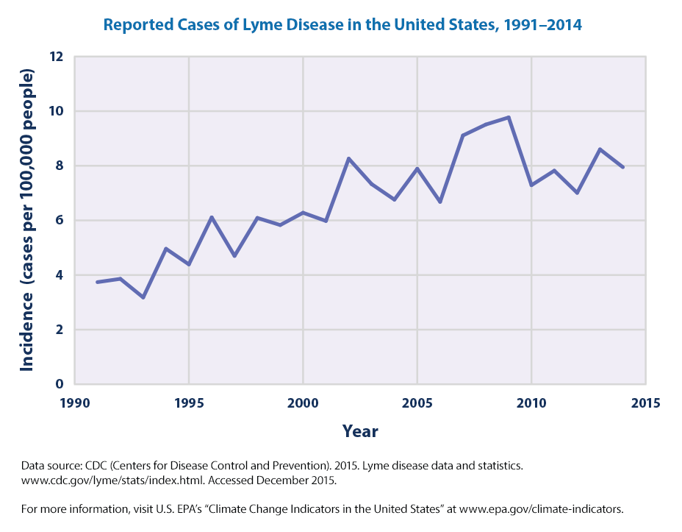
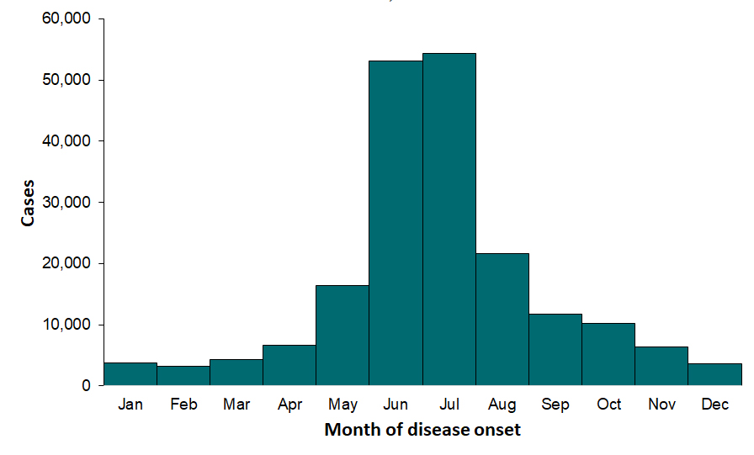
Vision
Cost/Incidence of Lyme disease in year 2020
*extend to Canada if data available
X +/- Y likely cases
Expected distribution:
Climate models
Model 1
Model 2
2000
Year
2030

